Slide 1
APC
Online Examination System
Lavanaya Goyal, 2310990642
Maanya Chopra, 2310990645
Manshika, 2310990650
Mehak, 2310990655
Class Group: 8
Team Name: InnoSphere
Project Id: APC-2023
Project Guide Name :
Mohammad Imran
APC Trainer

Slide 2
Introduction
A) PROJECT GOALS:
The main goal of our Online Examination System is to make exams easier and faster by using a digital platform instead of paper. It helps in saving time for both students and teachers by checking answers automatically and showing results instantly. The system also provides a leaderboard for fair comparison of scores, making the exam process more transparent. Overall, it reduces manual work, avoids mistakes, and gives a simple and user-friendly way to conduct exams.
B) OBJECTIVES:
The main objective of the Online Examination System is to provide a simple and reliable platform for conducting exams online. It allows students to log in, attempt questions, and get their results immediately without waiting. For teachers, it makes managing questions, users, and scores much easier by reducing manual effort. The system also ensures accuracy in checking, saves time, and creates a fair environment through features like instant evaluation and leaderboard.
C) VISUAL IDEA:
A simple web-based platform with main pages like Index, Exam, Result, and Leaderboard to guide students smoothly through the exam process.
Clean and user-friendly interface that allows students to log in, attempt questions, and instantly view results without confusion.

Slide 3
Problem Statement
The traditional way of conducting examinations has many challenges. Preparing question papers, printing, distributing, and then manually checking answer sheets requires a lot of time and effort from teachers. Students also face delays in receiving their results, which affects quick feedback on their performance. Maintaining records for large groups of students becomes difficult, and mistakes in evaluation are common. These issues make the overall process slow, resource-heavy, and less reliable.
The main problem is the absence of automation in the examination system. Without digital support, exams depend heavily on manual work, which increases the chances of errors and consumes more resources. Therefore, there is a strong need for a system that can automate exams, reduce human effort, ensure accuracy, and provide quick results in a simple and transparent way.

Slide 4
System Overview
The Online Examination Platform is a comprehensive web-based system designed to streamline the exam process for both students and teachers. Students can securely take exams online from anywhere, eliminating the need for physical attendance. The system supports various question types such as multiple-choice, short answer, and descriptive questions.
Teachers can create, schedule, and manage exams easily, with automated evaluation for objective questions and digital submission for subjective answers. Real-time results and performance analytics help students track progress and identify areas of improvement. Overall, the platform reduces manual work, ensures accuracy in grading, and provides a fast, convenient, and organized examination experience.

Slide 5
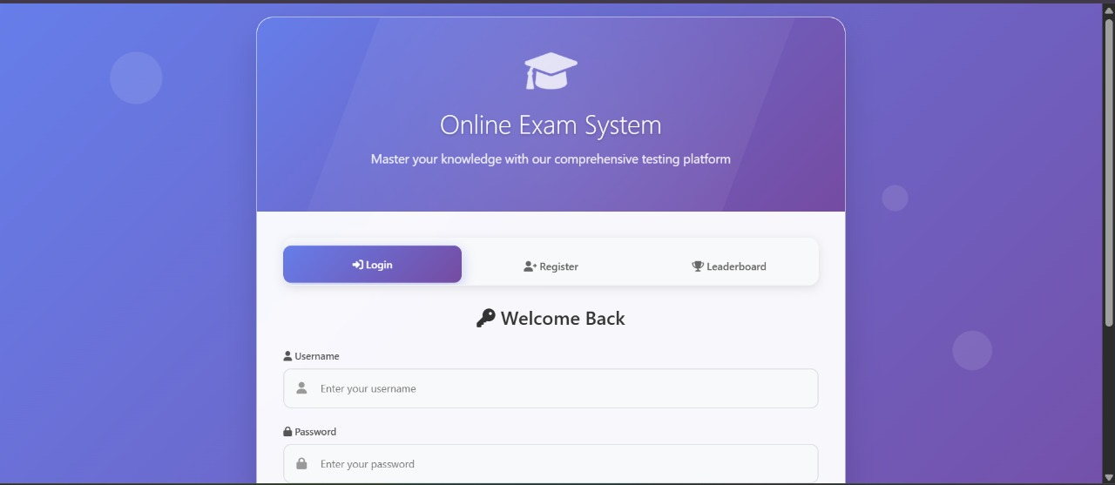
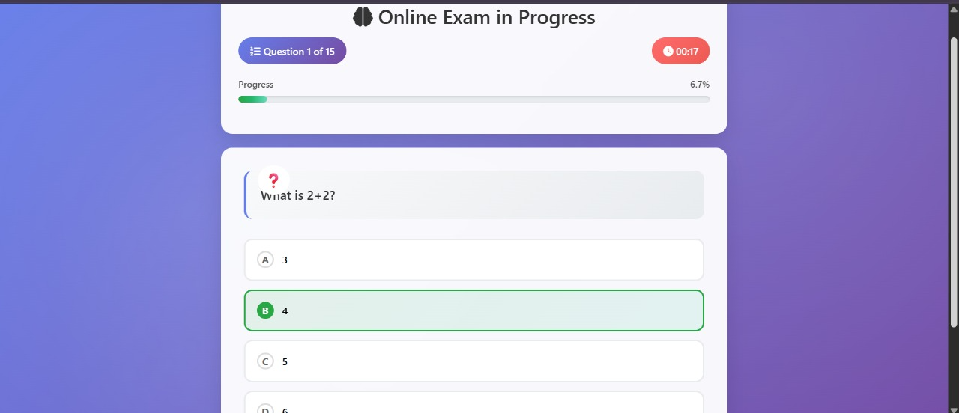

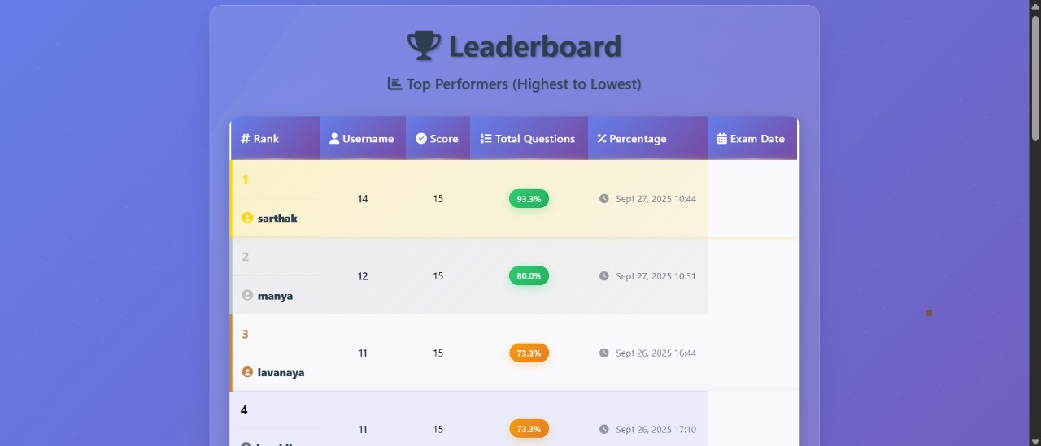
PROJECT OVERVIEW

Slide 6
Key Features
User Registration & Login – Secure, role-based login for students and admins with quick access.
Exam Taking & Instant Results – Students can take exams and view results instantly with detailed feedback.
Leaderboard & Performance Tracking – Real-time leaderboard with rankings and performance progress.
User Profiles & Records – Students can view their history, scores, and personal performance insights.

Slide 7
Exam & Question Management
Admins can create, edit, and schedule exams.
Add, update, or remove questions with options and answers.
Set time limits, difficulty levels, and grading patterns.
Ensure real-time updates for exams and question banks.

Slide 8
User Registration &Login
A secure and streamlined registration process allows students to create accounts effortlessly.
Role-based login ensures that admins manage exams while students access tests and results, improving security.
The system provides a fast, intuitive, and user-friendly login experience across devices.

Slide 9
Leaderboard & Performance Tracking
The platform features a dynamic leaderboard showcasing top scorers and ranks in real-time.
Students can monitor their progress over multiple exams and identify strengths or weaknesses.
This competitive yet motivating feature encourages continuous improvement and boosts engagement.

Slide 10
Responsive & Role-Based Access
Role-based login system ensures students, teachers, and admins only access features relevant to them.
Enhances security by restricting sensitive actions (like exam creation or result management) to admins only.
Provides a clear and organized user experience by showing each user their specific tools and dashboards.

Slide 11
Conclusion
The Online Examination Platform is a modern, efficient, and secure solution that transforms the traditional examination process into a fully digital experience. It ensures that students can take exams from anywhere, while teachers can manage, schedule, and evaluate exams with ease. By automating the grading of objective questions, the system significantly reduces manual effort, saves time, and minimizes errors.
The platform also provides real-time results and performance analytics, helping students understand their strengths and areas for improvement. Its support for multiple question types makes it flexible for different assessment needs. With secure access, organized record-keeping, and user-friendly design, the system ensures fairness, transparency, and reliability in examinations.
Overall, this platform enhances the overall efficiency of the examination process, improves the learning experience, and aligns with modern educational needs by making exams more accessible, organized, and technologically advanced. It is a step forward in creating a smarter, faster, and more effective way of conducting exams in educational institutions.

Slide 12
Thank you

